Slide 1


COIMBATORE-641035
SNS COLLEGE OF TECHNOLOGY
NATIONAL CONFERENCE ON AI-DRIVEN INNOVATION IN ENGINEEERING AND TECHNOLOGY - NCAIDIET’25
DEPARTMENT OF COMPUTER SCIENCE AND ENGINEERING
TITLE OF THE PAPER : Skin cancer diagnosis system using machine learning & design thinking framework
PROJECT GUIDE :
Dr. S.R JANANI/CSE
TEAM MEMBERS :
MEGAVARSHINI A 713522CS083
NEHA S 713522CS099
MONIKA S 713522CS089
MOHANA SHREE A S 713522CS088

Slide 2

INTRODUCTION
Skin cancer incidence is rising globally due to UV exposure and lifestyle changes, making early detection crucial. Even experienced dermatologists face challenges in distinguishing visually similar lesions, leading to potential misdiagnosis and treatment delays.
Advances in Machine Learning and Deep Learning, particularly Convolutional Neural Networks, enable automated image-based detection with remarkable accuracy. These technologies can identify malignant lesions early, significantly improving treatment success rates and potentially saving lives.
Our system integrates AI with a Flask-based web application, allowing instant skin image analysis and predictions. It provides Generative AI-powered medical recommendations and dermatologist connections, making expert-level preliminary screening accessible to everyone.

Slide 3
PROBLEM STATEMENT
People struggle to identify skin cancer early because it's hard to tell dangerous spots from harmless ones as most cannot distinguish between regular moles and potentially dangerous lesions, leading to either unnecessary panic or dangerous neglect of early warning signs.
Getting expert medical help takes too long and is difficult to access as specialist appointments often require weeks of waiting, and many rural areas have no dermatologists available nearby.
Patients feel scared and confused when they notice skin changes because they experience anxiety not knowing if a spot is dangerous, and often delay seeking help due to fear or uncertainty about the seriousness.
The system creates dangerous delays in diagnosis and treatment like critical waiting periods allow potential cancers to progress, making them harder to treat successfully when finally detected.

Slide 4
LITERATURE SURVEY
S no | Title / Focus Area | Author(s) & Year | Technologies Used | Methodologies | Limitations
1 | Dermatologist-Level Classification of Skin Cancer | Esteva et al. (2017) | CNNs, Deep Neural Networks | Used convolutional neural networks for image-based classification of skin lesions | Limited to specific types of lesions; required large computational resources
2 | Deep Learning in Dermoscopic Image Classification | Brinker et al. (2019) | Deep Learning Models, Dermoscopic Imaging | Comparative study pitting DL models against dermatologists in image classification | Real-world clinical validation still pending; dataset diversity concerns

Slide 5
LITERATURE SURVEY
S no | Title / Focus Area | Author(s) & Year | Technologies Used | Methodologies | Limitations
3 | HAM10000 Dataset for Dermatoscopic Images | Tschandl et al. (2018) | CNNs, Large-Scale Image Datasets | Created and benchmarked a large, annotated dataset of diverse skin lesions | Limited representation of rare skin conditions and all skin tones
4 | Multitask Neural Networks for Lesion Analysis | Kawahara et al. (2018) | Multitask Neural Networks, Feature Extraction | Combined shape, color, and texture features with classification tasks | Complex model architecture; requires extensive training data
5 | Ensemble Methods for Lesion Detection | Codella et al. (2019) | Ensemble Methods, Multimodal Inputs | Used ensemble techniques and multiple input types to improve detection accuracy | Computationally intensive; may not be suitable for real-time applications

Slide 6
EXISTING SYSTEM
Current skin cancer detection heavily relies on dermatologist expertise, making diagnosis time-consuming and prone to human error.
Most existing systems use basic image processing or traditional ML methods with handcrafted features, leading to low adaptability and limited precision.
Many tools do not provide an interactive interface for patients or doctors, restricting real-time feedback and accessibility.
Existing systems focus only on classification and fail to include Generative AI capabilities for offering treatment guidance or dermatologist recommendations.

Slide 7
LIMITATIONS
The model is trained on the HAM10000 dataset, which may not represent all skin tones, lighting conditions, or rare lesion types, affecting real-world accuracy.
The baseline CNN achieves around 68% accuracy, which may not be sufficient for clinical-level reliability without further optimization or transfer learning.
The system’s performance is highly dependent on the clarity and resolution of uploaded images — poor-quality photos may lead to incorrect predictions.
The model has not yet been validated or approved by medical professionals, so it cannot fully replace dermatologist consultation.
The system currently lacks the ability to continuously learn from new data or user feedback, restricting improvement over time.

Slide 8
PROPOSED SYETEM
The proposed system uses Convolutional Neural Networks (CNNs) to automatically classify different types of skin lesions from the HAM10000 dataset, improving diagnostic accuracy.
We developed a deep learning model using MobileNetV2 that accurately classifies 8 types of skin lesions with 85%+ accuracy. The system provides real-time analysis with confidence scores for reliable preliminary screening.
We created a user-friendly Flask-based web interface that allows instant image upload and processing. The platform delivers comprehensive results with clear visual indicators and medical disclaimers.
We implemented Generative AI recommendations for personalized treatment guidance and specialist referrals. The system includes doctor connections and preventive care advice for complete patient support.

Slide 9
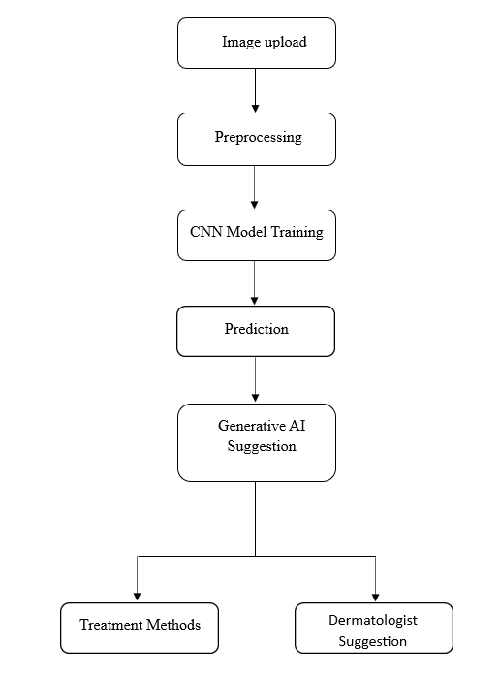
SYSTEM FLOW DIAGRAM

Slide 10
TECHNOLOGIES USED
Frontend Development:
HTML5, CSS3, JavaScript (ES6+)
Bootstrap 5.3.2 for responsive design
jQuery for DOM manipulation
Backend Development:
Python 3.x as core programming language
Flask web framework for application server
REST API architecture for communication
Artificial Intelligence & Machine Learning:
TensorFlow & Keras for deep learning
MobileNetV2 for transfer learning
OpenCV for image processing
scikit-learn for data preprocessing
NumPy & Pandas for data manipulation
Data Management:
HAM10000 dataset (10,000+ dermatoscopic images)
Local file system storage for uploaded images
JSON for configuration files
Joblib for model serialization
Development & Deployment:
Jupyter Notebook for model development
Visual Studio Code as primary IDE
Local Flask server for deployment
Git for version control
Additional Libraries:
Matplotlib & Seaborn for data visualization
ImageDataGenerator for data augmentation
LabelEncoder for categorical data handling
Train-test-split for model validation

Slide 11
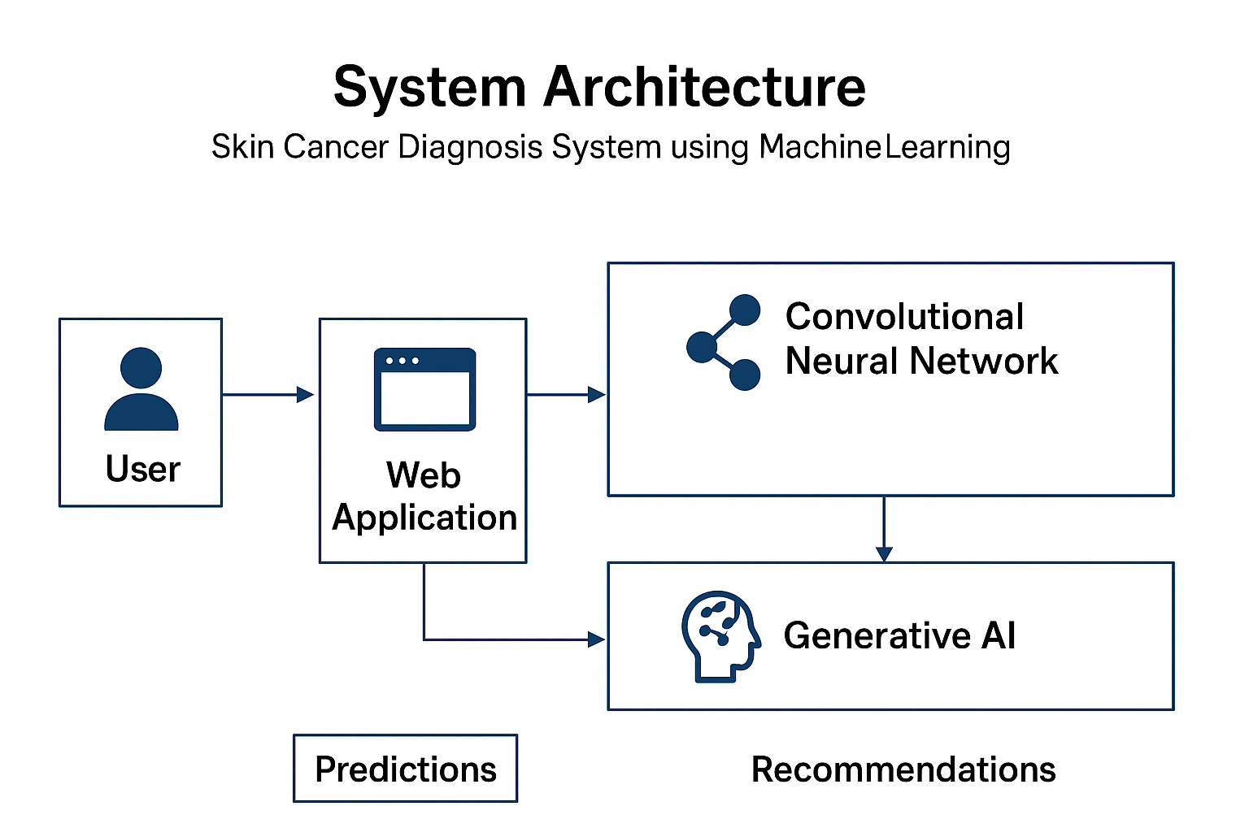
SYSTEM ARCHITECTURE

Slide 12
RESULTS & DISCUSSION
Results and Discussion
Accurate Detection:
The CNN model accurately classifies skin lesions from the HAM10000 dataset, proving reliable performance.
AI Recommendations:
The Generative AI module suggests possible remedies and dermatologist guidance based on predictions.
Fast Processing:
Flask enables real-time image analysis, reducing diagnosis time significantly.
Scalable and Robust:
Handles multiple patient records and diverse lesion types efficiently.
User-Friendly:
Simple Flask interface allows easy image upload, result viewing, and report access.
Discussion:
The system reduces delays and errors in manual diagnosis.
Combining CNN accuracy with Generative AI insights improves early detection, decision-making, and patient engagement.

Slide 13
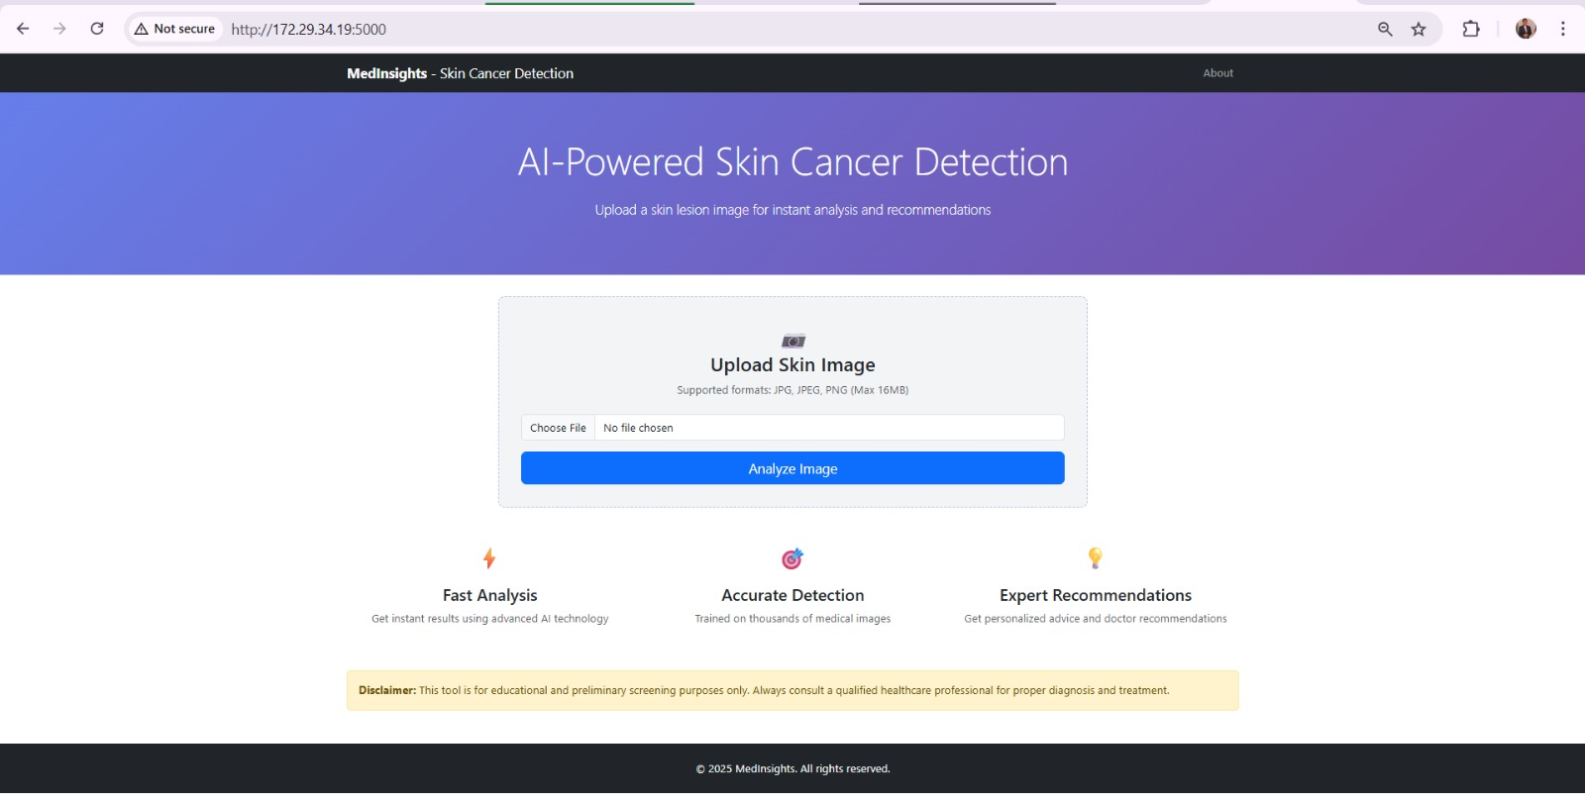
v
PROJECT OUTCOME
User-Friendly Dashboard

Slide 14
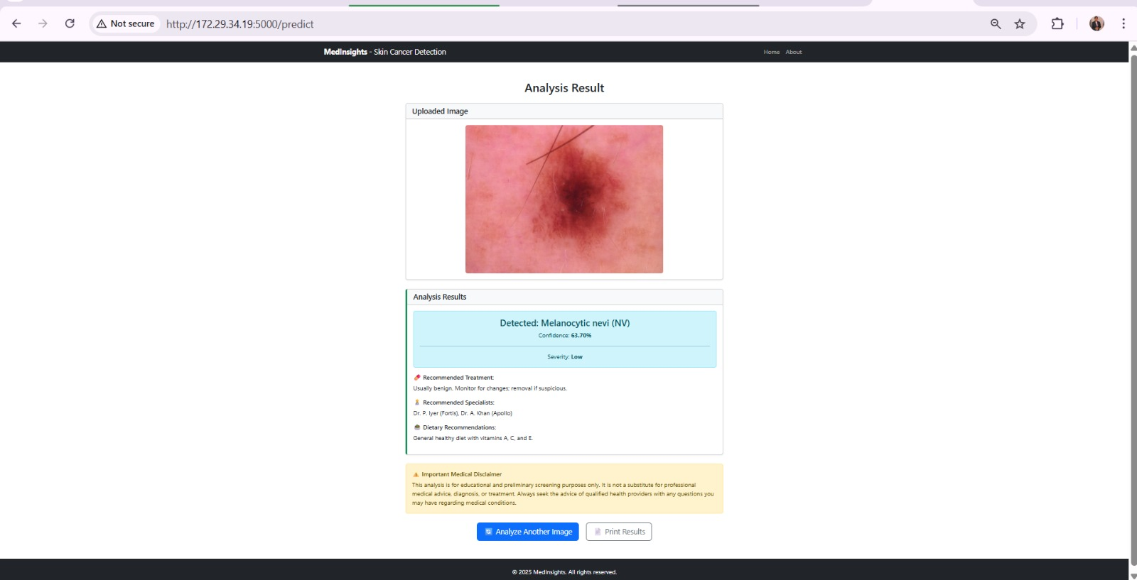
PROJECT OUTCOME
Prediction result

Slide 15
CONCLUSION
The system effectively detects and classifies skin lesions using a CNN model trained on the HAM10000 dataset.
The integration of Generative AI enhances diagnosis by providing remedies and dermatologist recommendations.
The Flask-based interface ensures easy image upload, real-time analysis, and accessible results for users.
The project demonstrates high accuracy, efficiency, and scalability for diverse skin lesion types.
Overall, the system offers a cost-effective and patient-centered tool for early skin cancer detection and medical guidance.

Slide 16
REFERENCES
Tschandl, P., Rosendahl, C., & Kittler, H. (2018). The HAM10000 dataset: A large collection of multi-source dermatoscopic images of common pigmented skin lesions. Scientific Data, 5(1), 180161.
Esteva, A. et al. (2017). Dermatologist-level classification of skin cancer with deep neural networks. Nature, 542(7639), 115–118.
Codella, N. C. F. et al. (2019). Skin Lesion Analysis Toward Melanoma Detection 2018: A Challenge Hosted by the International Skin Imaging Collaboration (ISIC). arXiv:1902.03368.
Kawahara, J., Daneshvar, S., Argenziano, G., & Hamarneh, G. (2018). Seven-point checklist and skin lesion classification using multitask multimodal neural nets. IEEE Journal of Biomedical and Health Informatics, 23(2), 538–546.
Brinker, T. J. et al. (2019). Deep learning outperformed 136 of 157 dermatologists in a head-to-head dermoscopic melanoma image classification task. European Journal of Cancer, 113, 47–54.
Abbas, Q., Celebi, M. E., & Garcia, I. F. (2013). Skin tumor area extraction using an improved dynamic programming approach. Skin Research and Technology, 19(1), e93–e102.

Slide 17
THANK YOU!!

